Slide 1

Burned area detection based on satellite data
P2M PROJECT
Presented by:
Tarek Bouchoucha
Alaa Ben Turkia
Supervised by:
Mr. Riadh Abdelfatteh

Slide 2


Table of contents
01
Context of the project
02
Project development and results
03
Concluion

Slide 3

Context of the project
1

Slide 4




PROBLEM
Increased frequency of forest fires and their difficult detection
Inadequacy of traditional ground-based methods for detection both in time and cost
Need for an efficient, accurate, and scalable solution for mapping the burned areas and their impacts
2
Notes:
Wildfires pose a significant challenge due to their unpredictable nature and rapid spread. These fires can devastate large areas in a short amount of time, making early detection and rapid response crucial. However, traditional ground-based methods for detecting and mapping burned areas come with several substantial limitations:
Labor-Intensive and Time-Consuming: Ground-based detection requires a considerable amount of manual effort and time, often involving extensive fieldwork that can delay the overall detection and response process.
Limited Accessibility: These methods are constrained to regions that are easily accessible. Remote or difficult-to-reach areas are often left unmonitored, leading to incomplete and delayed information.
Lack of Timely Data: Traditional methods fail to provide the immediate data needed for effective wildfire management. Delayed detection can result in slower response times, exacerbating the damage caused by the fire.

Slide 5

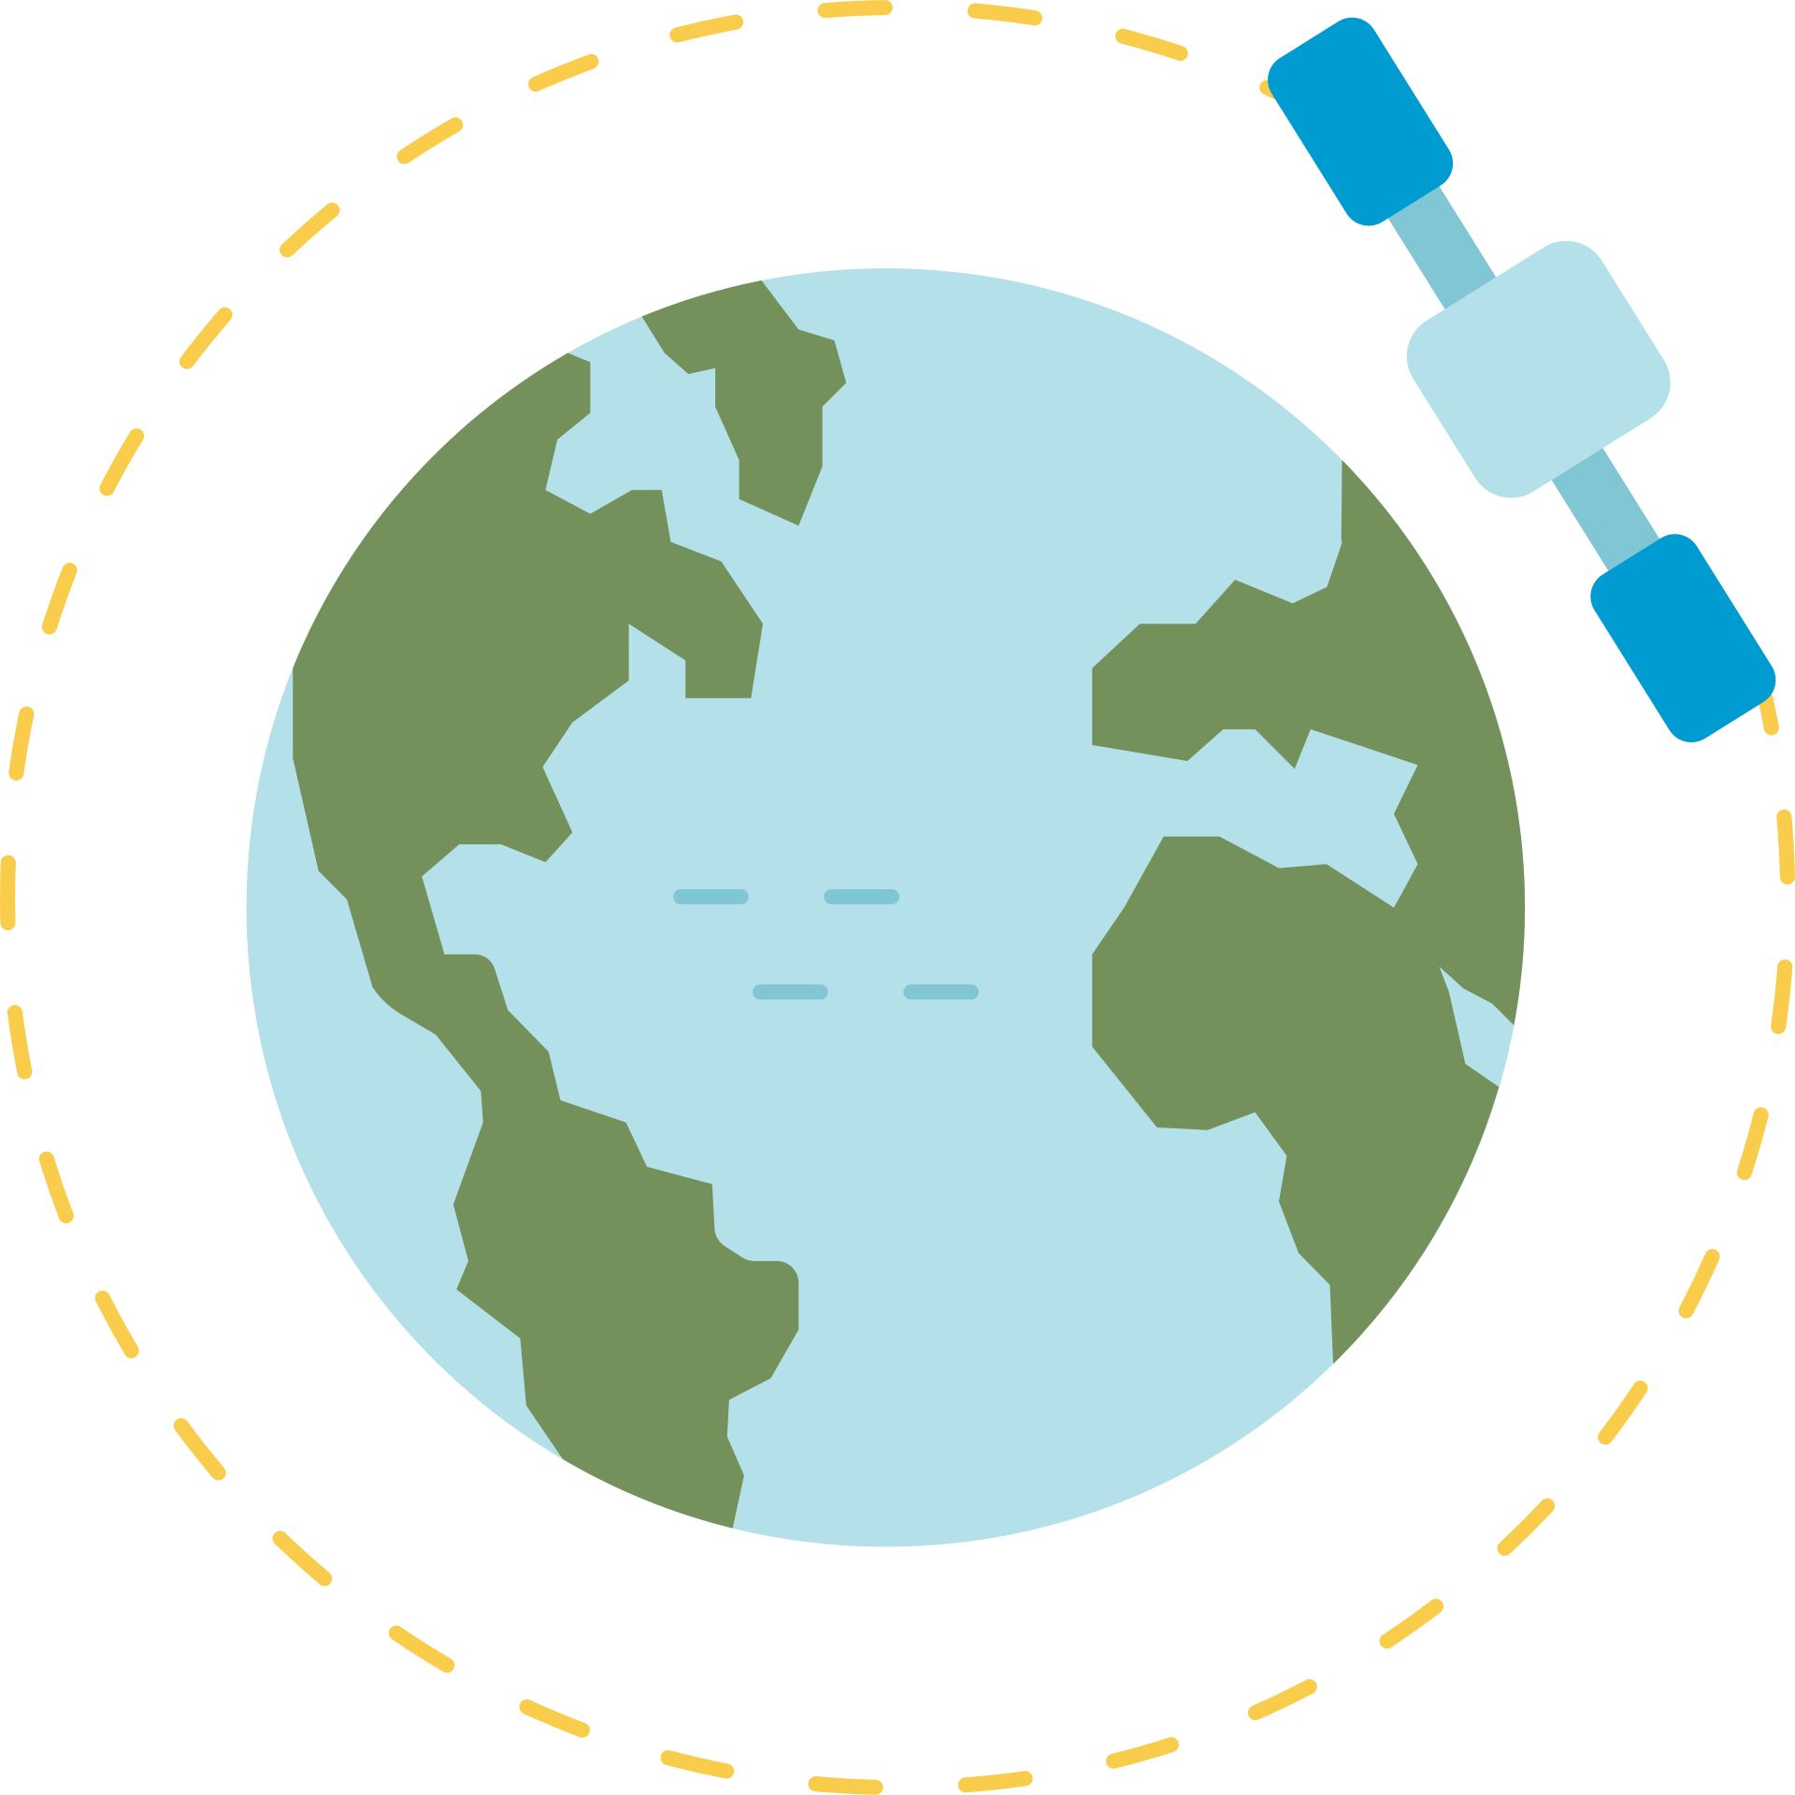


SOLUTION
+
Sentinel-2 Images
Computer vision approach
Precise and scalable detection
3
Notes:
To address these pressing issues, our work leverages satellite data, specifically using images from the Sentinel-2 satellites, in conjunction with advanced computer vision techniques. This innovative approach offers several key advantages:
Precision and Scalability: Satellite data allows us to cover extensive geographic areas with high-resolution imagery, enabling accurate and detailed detection of burned areas. This scalability means that we can monitor vast regions, including remote and inaccessible areas, ensuring comprehensive coverage.
Efficiency: The use of automated image processing and analysis significantly reduces the time and labor involved in traditional methods. By automating the detection process, we can provide near real-time data, facilitating faster and more effective wildfire management and response.

Slide 6




REQUIRED WORK
Acquiring the satellite images and preparing them for model training
testing the trained model on new images including Tunisian ones
choosing a fitting model for the application and training it
Developing a simple way of deployment
4

Slide 7
Project development
5

Slide 8

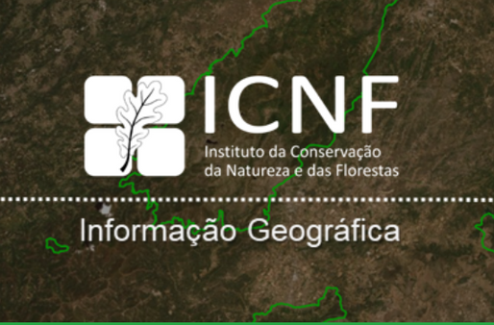
DATA ACQUISATION
Copernicus sentinel-2 browser
ICNF website
6

Slide 9
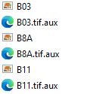
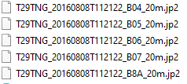

DATA PREPROCESSING
Atmospherically correct images using sen2cor and choose 20 meter per pixel resolution
2. Extract bands and transform them to .tiff using QGIS
7

Slide 10
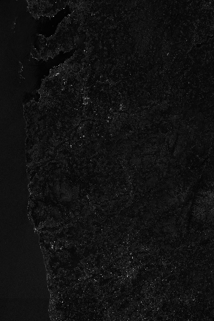
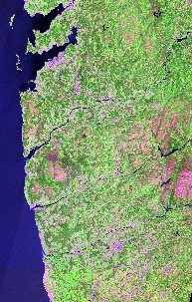
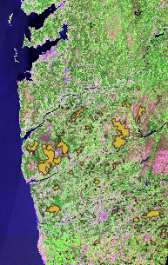

DATA PREPROCESSING
3. Merge the Green, NIR and SWIR bands
8

Slide 11
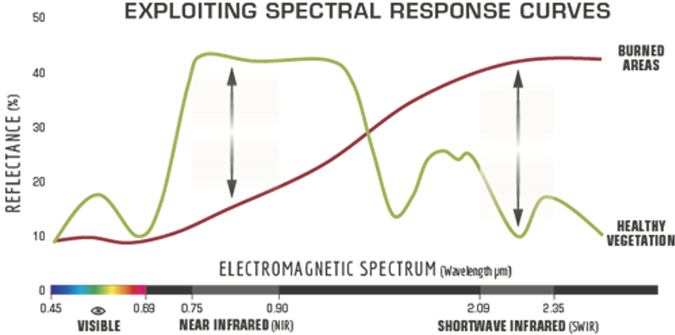
DATA PREPROCESSING
Spectral reflectance of healthy vegetation and burned vegetation in the different spectral bands (Wasser and Cattau 2020)
9

Slide 12
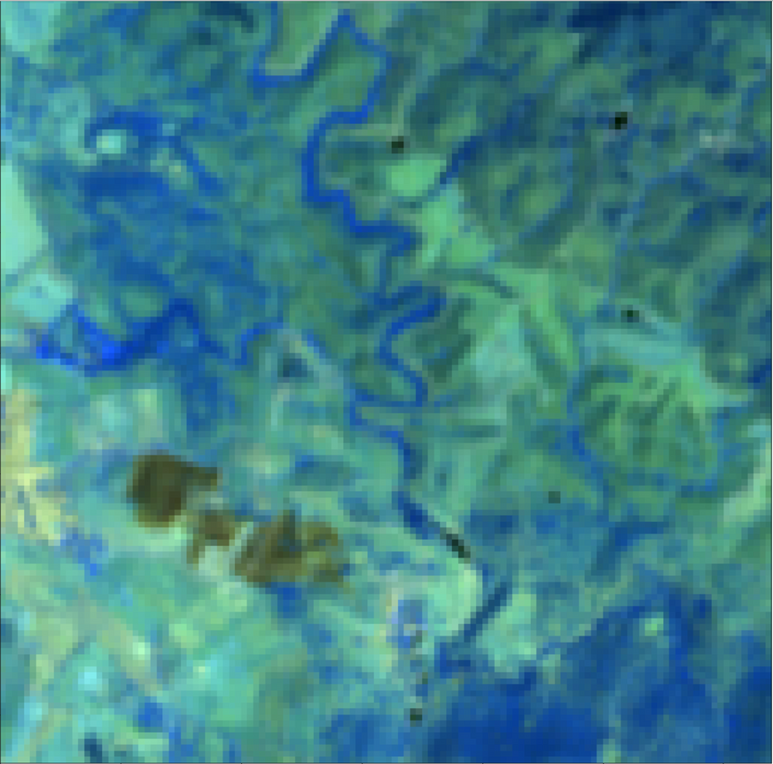
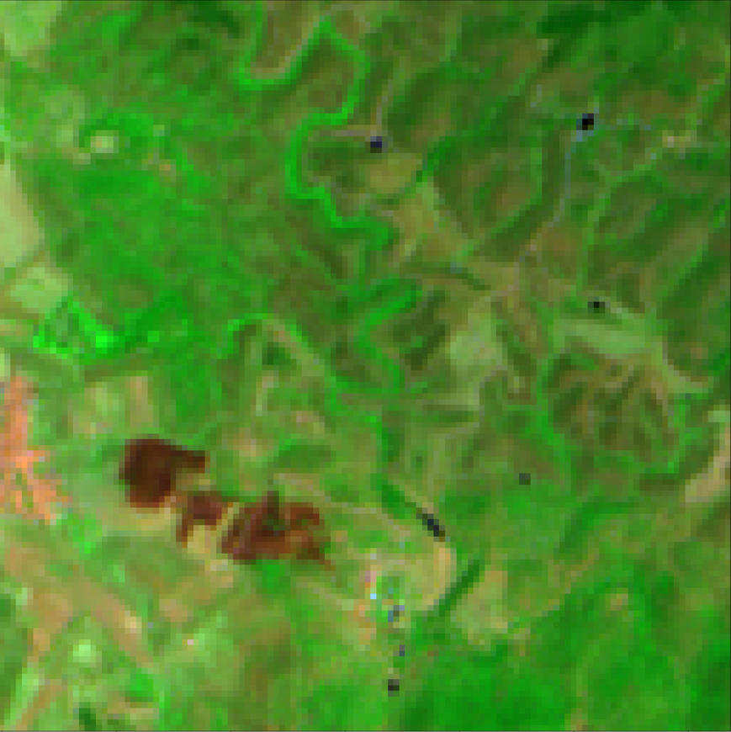
DATA PREPROCESSING
False-color images with a combination of SWIR-short, SWIR-long and NIR make burned areas visible but difficult to distinguish from their environment
Combination of SWIR, Green and NIR spectral bands emphasise burned areas as dark brown patches in a bright green environment
10

Slide 13
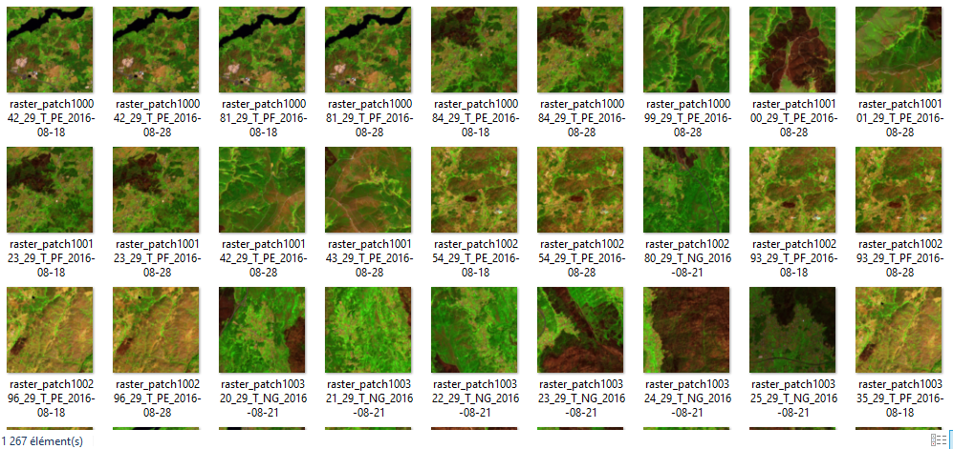
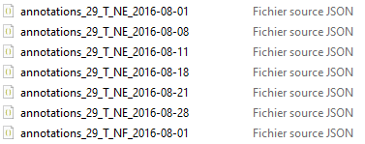
DATA PREPROCESSING
4. Match the BA ground truth data to the false-color images by area and date
5. Extract small patches of size 128x128 from the false-color images and ground truth data
6. Remove empty or broken patches from the datasets
11

Slide 14
DATA PREPROCESSING
7. Data augmentation
Flip: Horizontal, Vertical
90° Rotate: Clockwise, Counter-Clockwise, Upside Down
Noise: Up to 0.34% of pixels
1862 patches
3012 patches
8. Transform annotations from JSON to COCO format
9. Data split
878
70%
251
20%
127
10%
12

Slide 15

TRAINING
Chosen model:
You Only Look Once
Open source
easy to use and finetune with any image data
Accurate results
13

Slide 16
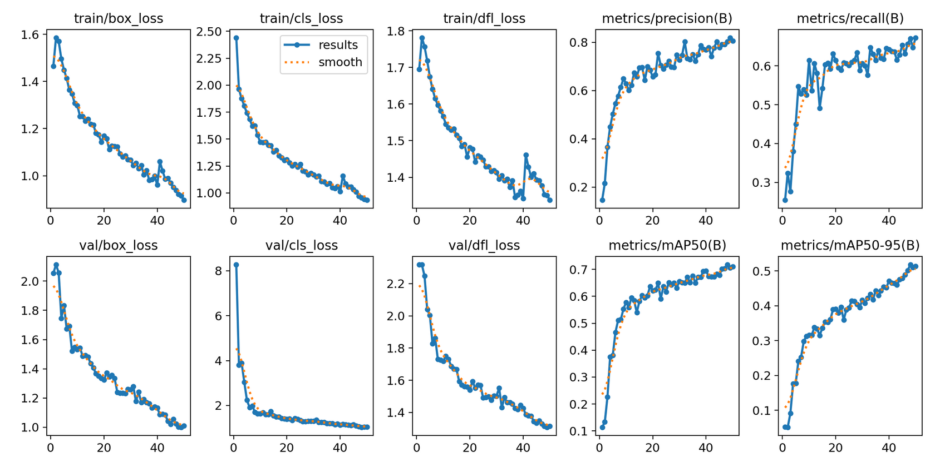
Training results
14

Slide 17
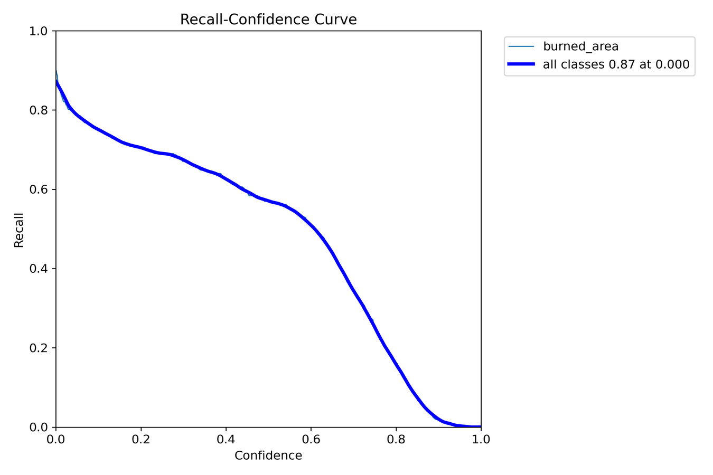
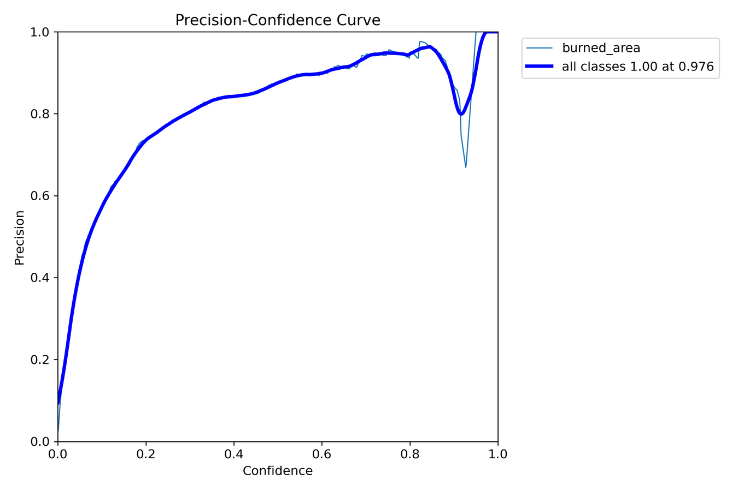
15

Slide 18
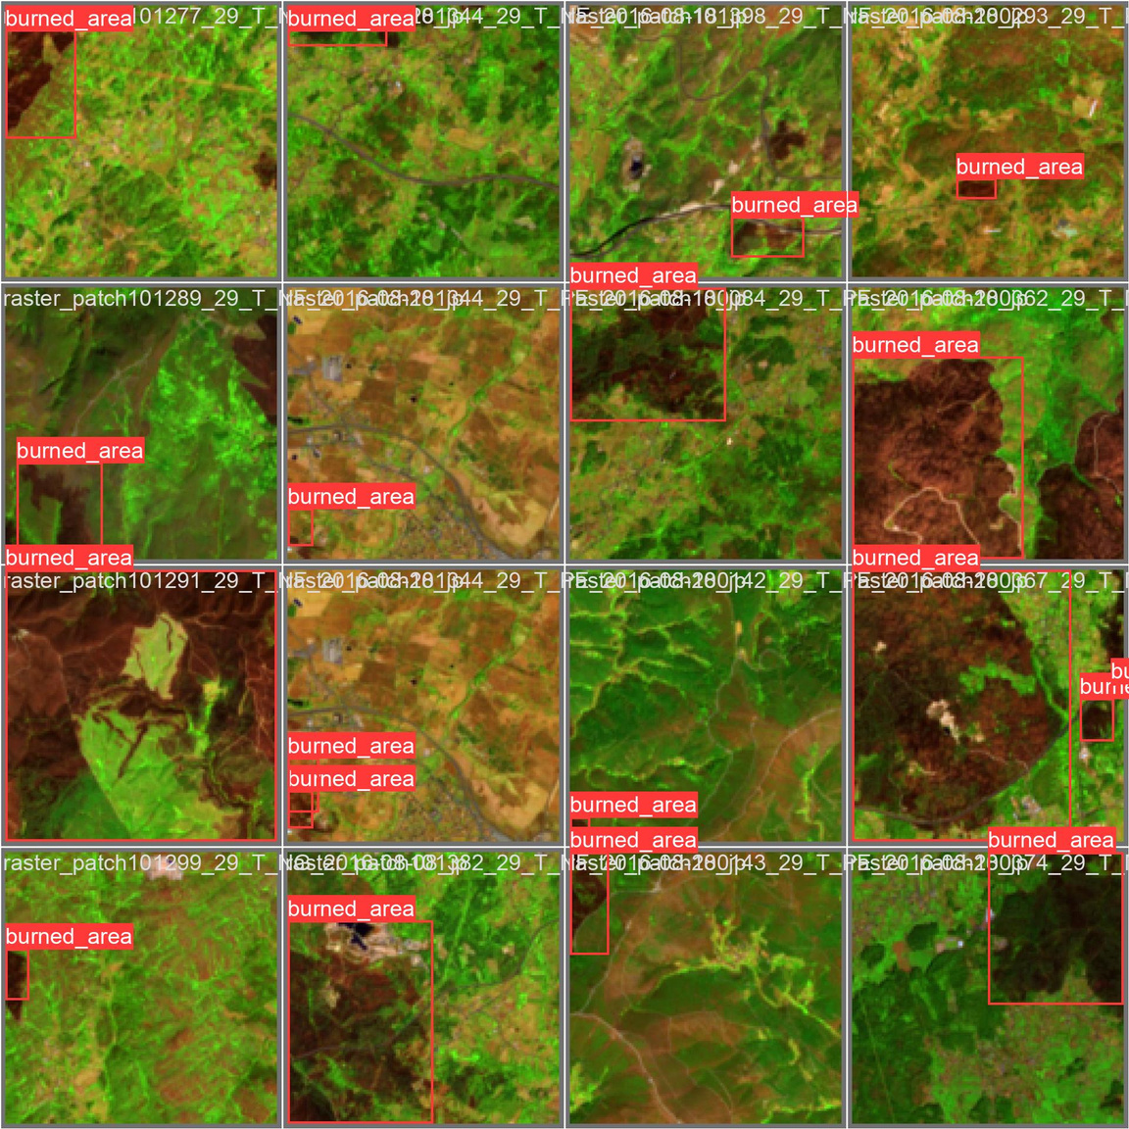
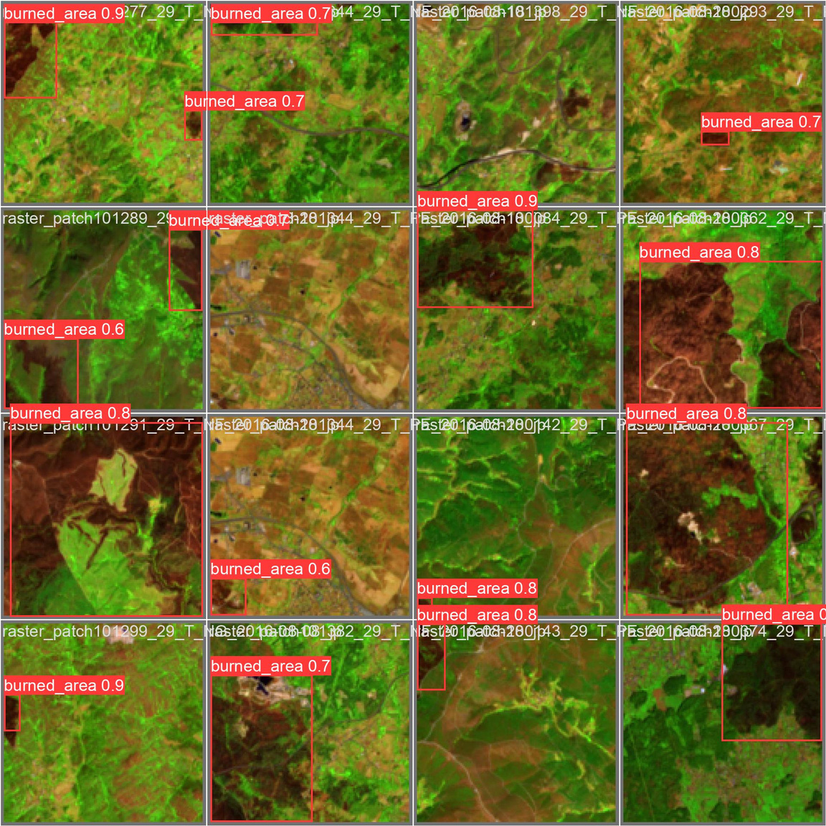
VALIDATION
16

Slide 19

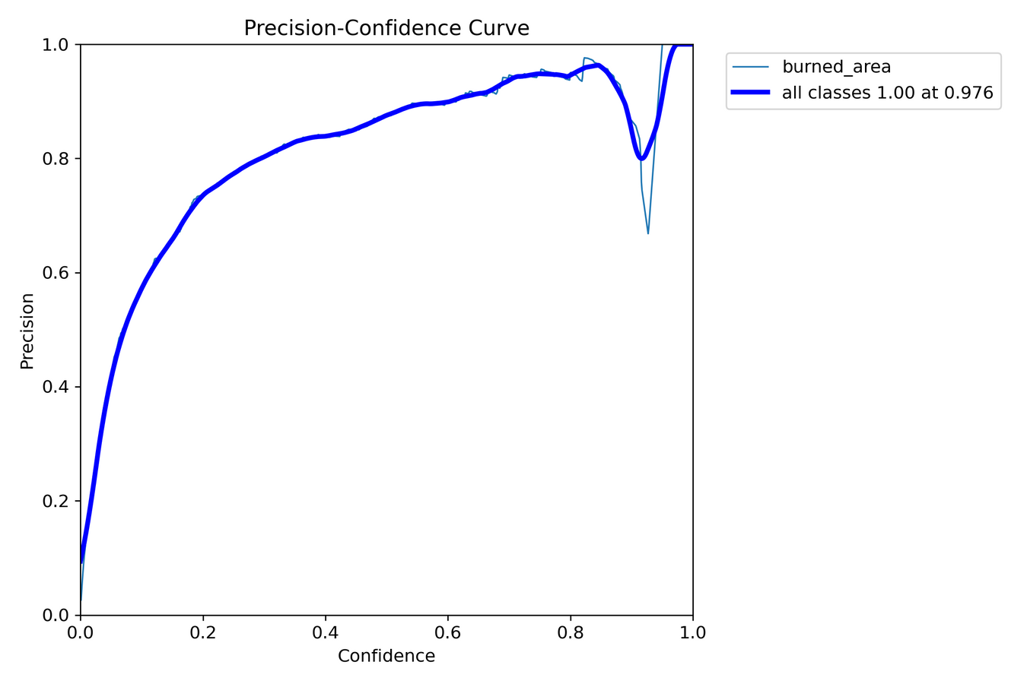
17

Slide 20
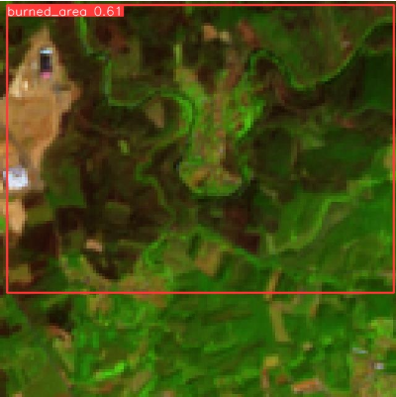
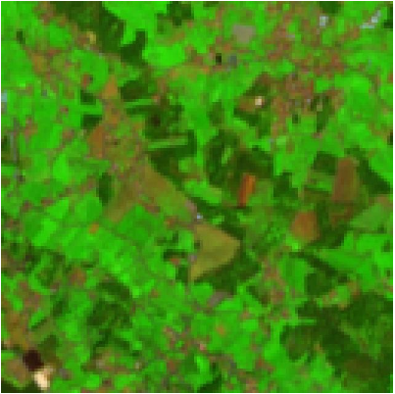
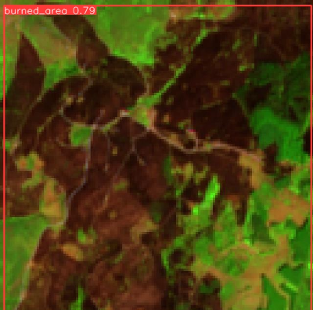
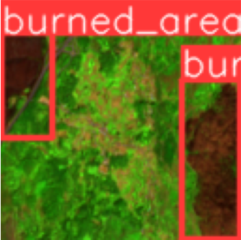
TESTING
18

Slide 21
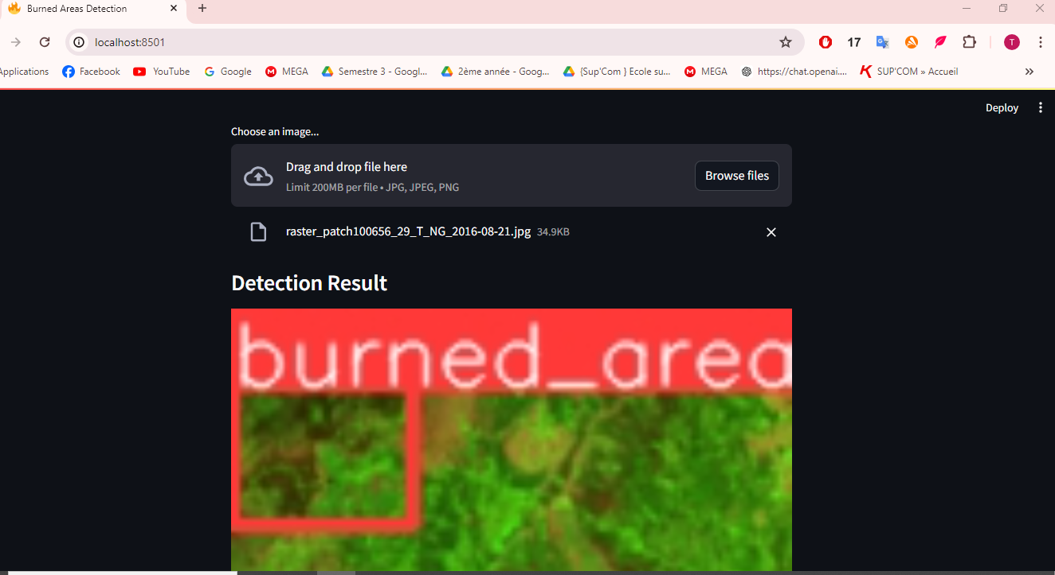
DEPLOYMENT
Simple deployment using Streamlit
19

Slide 22
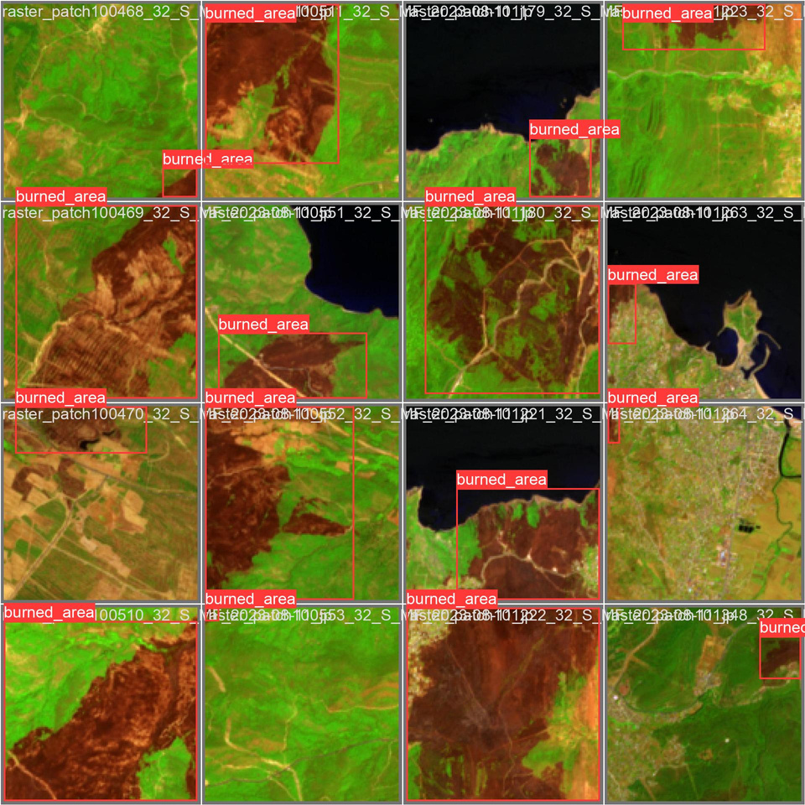
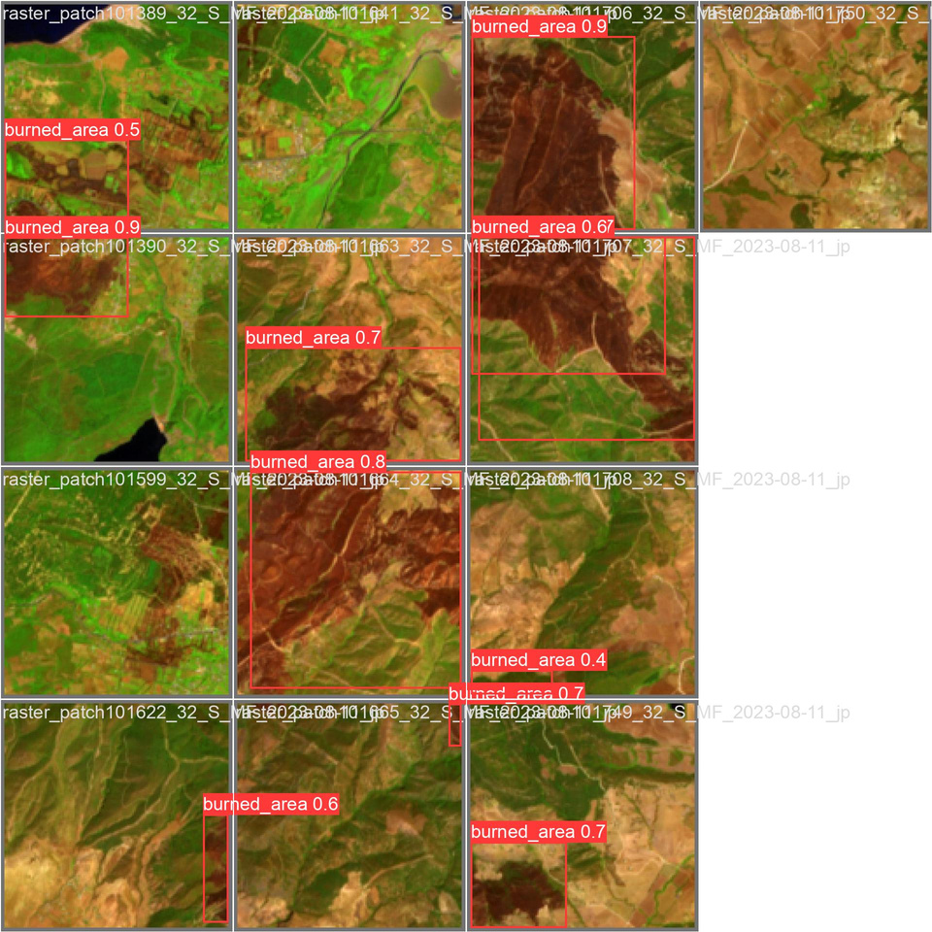
TESTING ON TUNISIAN DATA
20

Slide 23
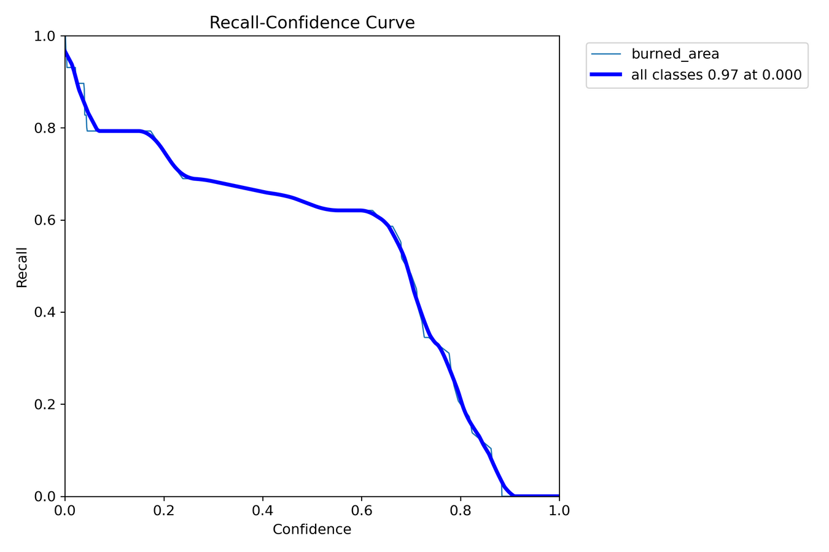
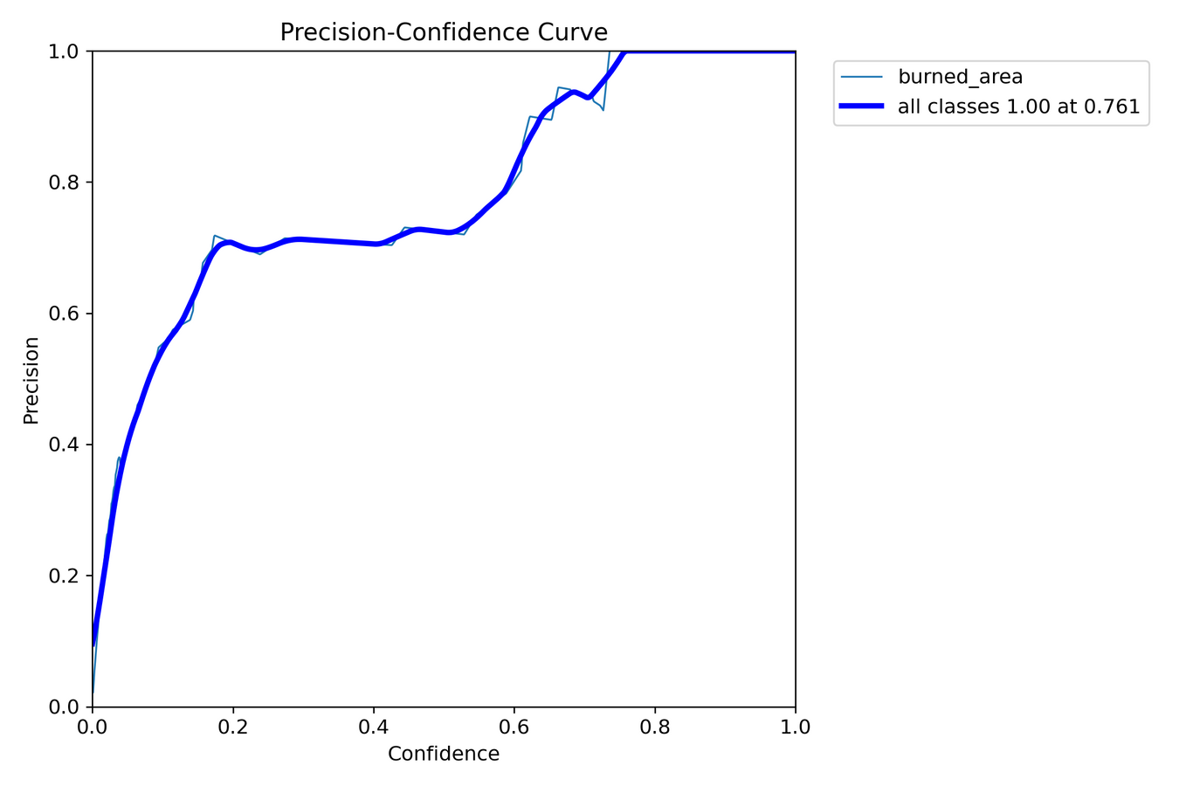
21

Slide 24
Conclusion
22

Slide 25

Thank you

